Slide 1
Autonomous Subway Inspection Vehicle
Phase 1 Presentation
Senior Design
Omar Aziz, Noah Bolzoni, Brandon Castro,
Anthony Lucero, Sean Maggio, Marcin Wisniowski
Advised by: Professor Connington
October 10th, 2019

Slide 2
Outline
Background
Project Statement & Issues
Design
Concept Selection
Project Plan
Moving Forward
State-of-the-Art Technology & Needs
Technical Analysis
Problem
Notes:
Marcin

Slide 3
Background
Notes:
Marcin

Slide 4
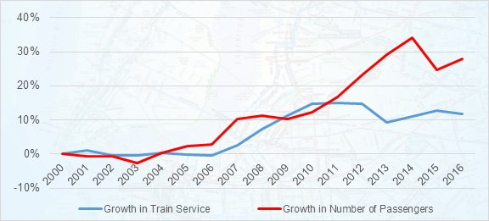
Background
Problem
5.7 million ride subway everyday
Subway system plagued by issues related to track defects
Manhattan subway service growth compared to ridership growth
(MTA, 2016)
Notes:
Marcin

Slide 5
Background
Project Statement
Motivation
Reactive inspection & maintenance cause high costs
Too many delays from undiscovered defects
Stagnant growth due to focus on keeping service running
Notes:
Marcin

Slide 6
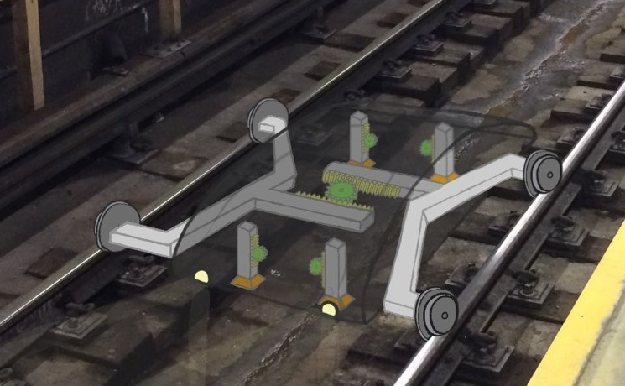
Background
Project Statement
Goals
Autonomous system to collect key track data
Detect defects more frequently by using multiple units
Reduce costs & delays
Minimize impact on service
Increase growth & efficiency
Autonomous Subway Inspection Vehicle Concept
Notes:
Marcin

Slide 7
Background
Project Statement
Major Issues
Lack of publicly available specs
Finding track that can be used for testing
Cooperation with MTA/PATH
Notes:
Marcin

Slide 8
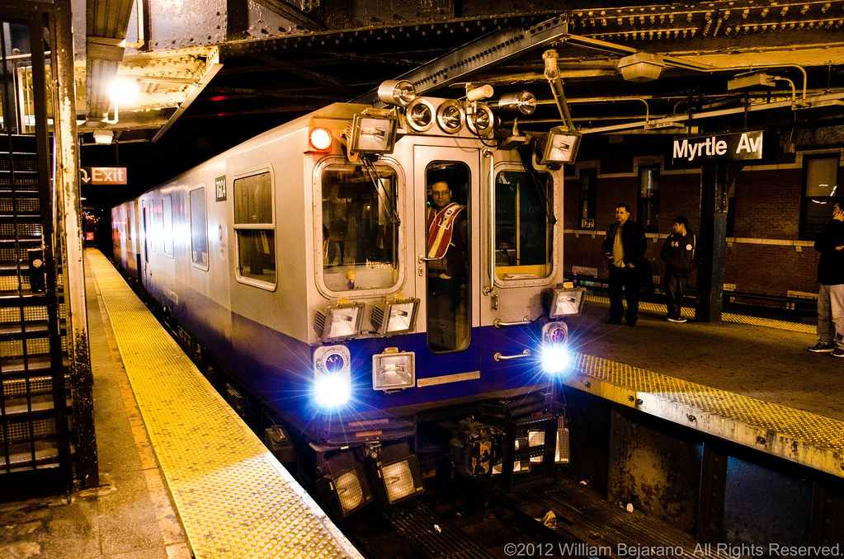
Background
Current Solution
Manual inspections
Track geometry cars
Large, expensive
Visual inspection
On foot, slow
MTA Track Geometry Car
(Bejarano, 2012)
Notes:
Brandon

Slide 9
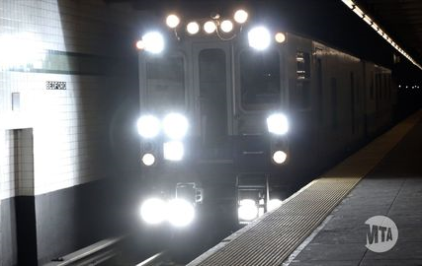
Background
State-of-the Art Technology - MTA Track Geometry Cars
Only 4 in service
Up to $2.5 million each
Manned by crew of 6+
Inspect over 670 miles
Full coverage only 6 times per year
MTA Track Geometry Car
(MTA, 2015)
Notes:
Brandon

Slide 10
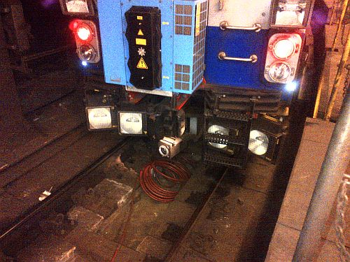
Background
State-of-the Art Technology - MTA Track Geometry Cars
High-tech sensors
Electro-mechanical
Inertial
Laser
Comprehensive analysis
Sensing Equipment
(MTA, 2012)
Notes:
Brandon

Slide 11
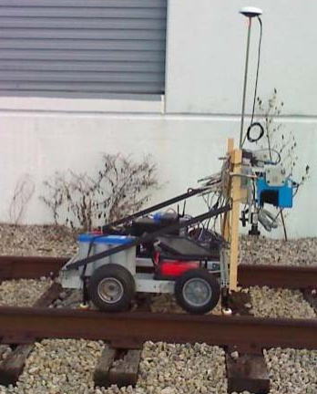
Background
State-of-the Art Technology – Central Florida Hi-Rail Truck Cameras
Research project
Lasers, cameras to detect defects
Machine learning & computer vision
Inconsistent results
UCF Mobile Railroad Cart
(University of Central Florida + FDOT, 2010)
Notes:
Brandon

Slide 12
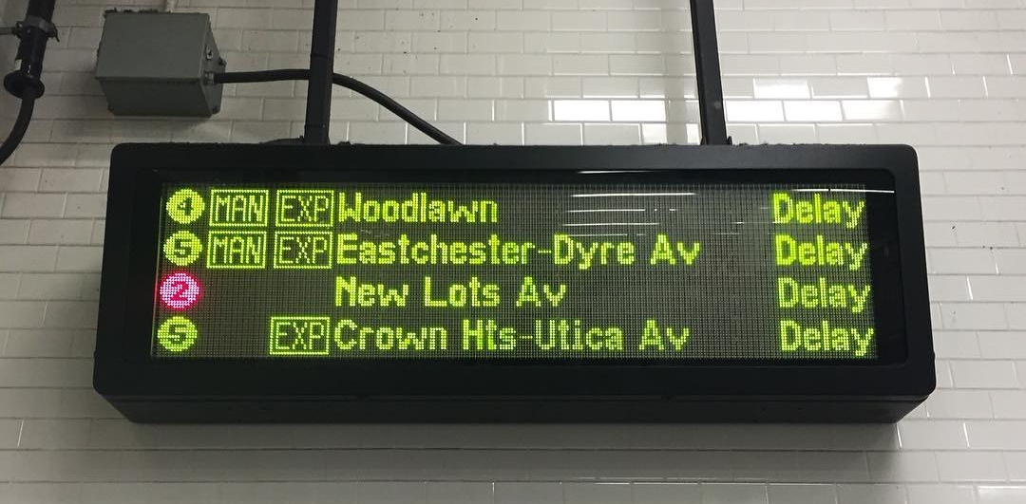
Background
Needs
Societal Needs
Commuters need efficiency & safety
Fewer delays & inconveniences
Increased service
MTA Subway Delays
(New York Magazine, 2016)
Notes:
Brandon

Slide 13
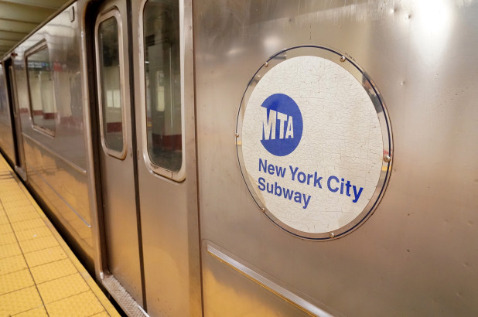
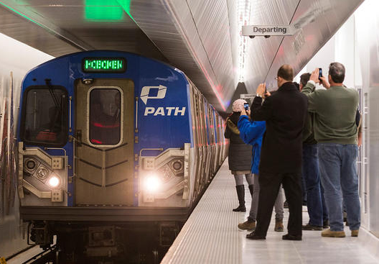
Background
Needs
Customer Needs
Cost-effective solution
Reliable measurements at higher frequency
Save space & time
Increase efficiency
Increase revenue
MTA & Path Trains
Notes:
Brandon

Slide 14
Concept Selection
Notes:
Sean

Slide 15
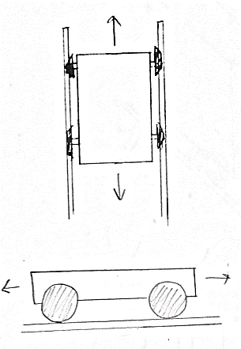
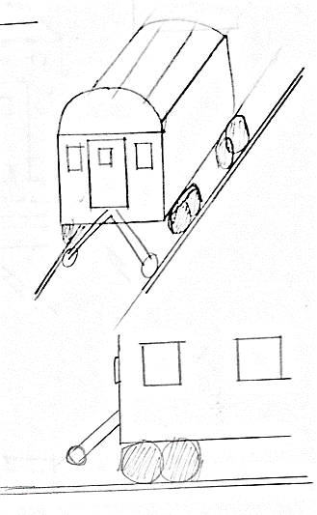
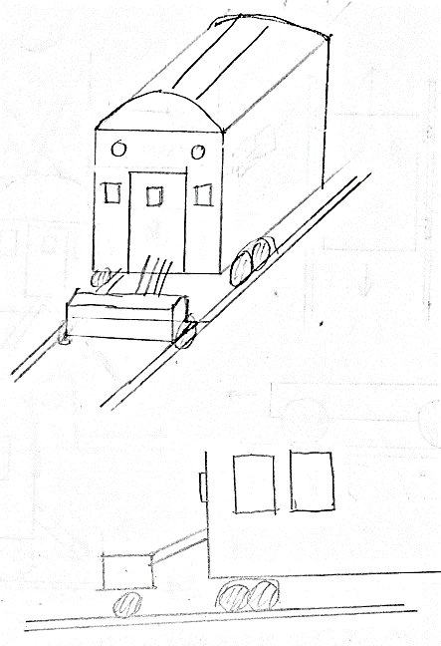
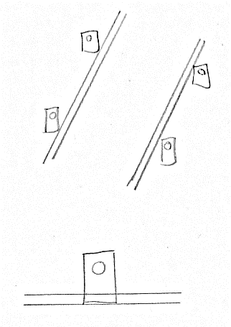
Concept Selection
Initial Concept Sketches
Autonomous
(Self-propelled)
Mounted
Pulled/Pushed Cart
Stationary Sensors
Notes:
Sean

Slide 16
Concept Selection
Method Selection Matrix
Selection Criteria | Autonomous | Car-Mounted | Car-Dragged/ Pulled | Stationary
Requires System Modification | + | 0 | 0 | 0
Ease of Use | 0 | + | 0 | +
Installation | + | - | 0 | -
Impact on Operations | 0 | + | - | +
Low Cost | + | + | + | -
Moving Parts | - | + | - | +
Unique | + | - | + | 0
Net | 3 | 2 | 0 | 1
Rank | 1 | 2 | 4 | 3
Continue? | Yes | Yes | No | No
Notes:
Sean

Slide 17
Concept Selection
Method Selection Matrix
Design |  | Autonomous |  | Car-Mounted
Selection Criteria | Weight | Rating | Weighted Score | Rating | Weighted Score
Impact on Operations | 25.00% | 3 | 0.75 | 5 | 1.25
Low Cost | 20.00% | 4 | 0.8 | 3 | 0.6
Requires System Modification | 15.00% | 5 | 0.75 | 3 | 0.45
Ease of Use | 15.00% | 3 | 0.45 | 3 | 0.45
Installation | 15.00% | 5 | 0.75 | 1 | 0.15
Moving Parts | 5.00% | 2 | 0.1 | 4 | 0.2
Unique | 5.00% | 5 | 0.25 | 1 | 0.05
Total Score |  | 3.85 |  | 3.15
Rank |  | 1 |  | 2
Continue? |  | Yes |  | No
Notes:
Sean

Slide 18
Concept Selection
Refining
Autonomous Vehicle
Measurement
What to Measure
How to Measure
Train Evasion
Trigger
Mechanism
Notes:
Sean

Slide 19

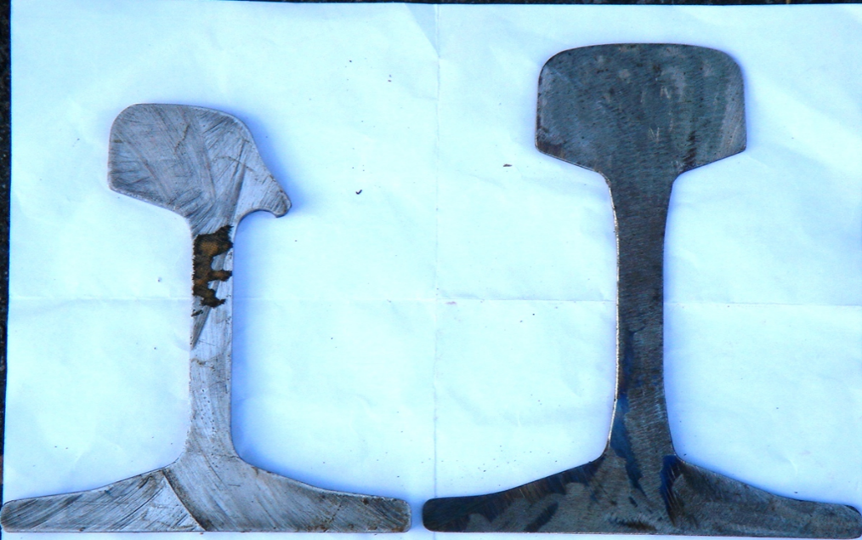
Concept Selection
What to Measure – Definite Values
Track Gauge
Rail Profile
Worn
New
Notes:
Sean

Slide 20
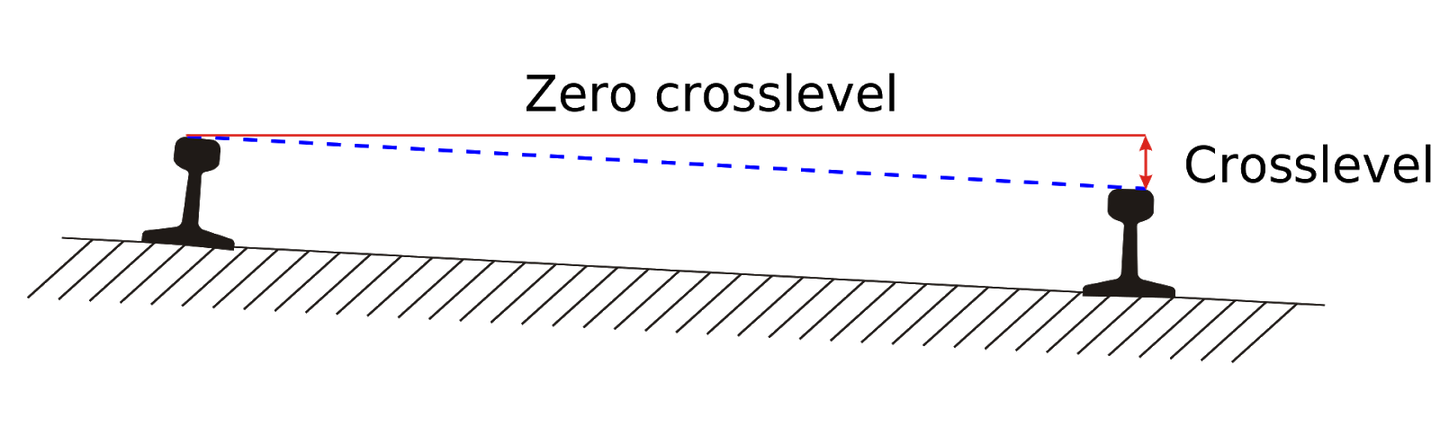
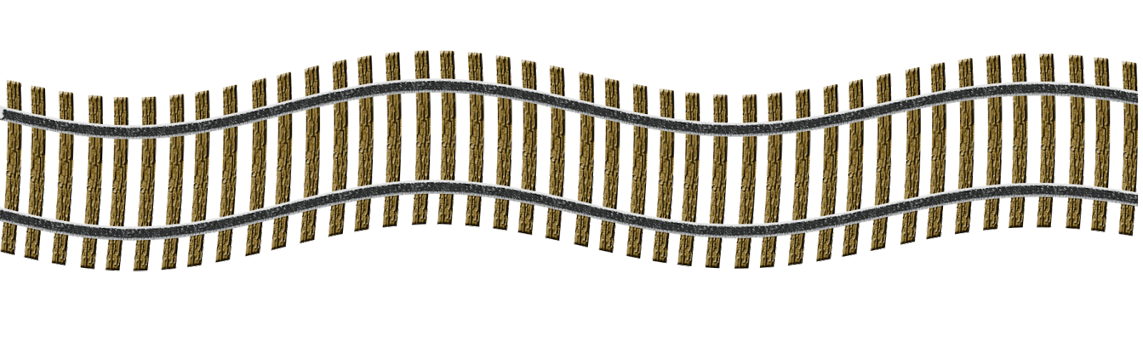
Concept Selection
What to Measure – Possible Values
Level Ground
Crosslevel
Curvature
Notes:
Sean

Slide 21
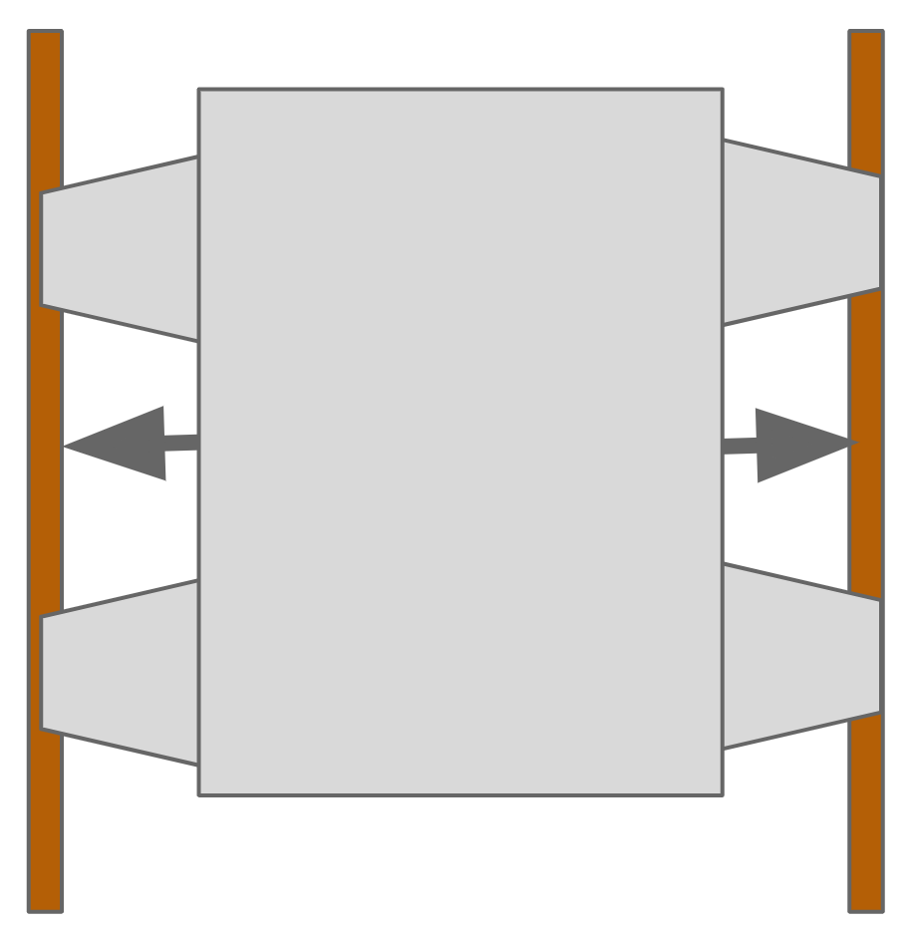
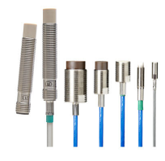
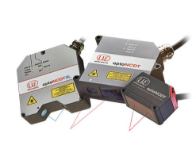
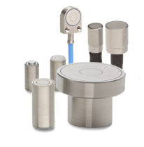
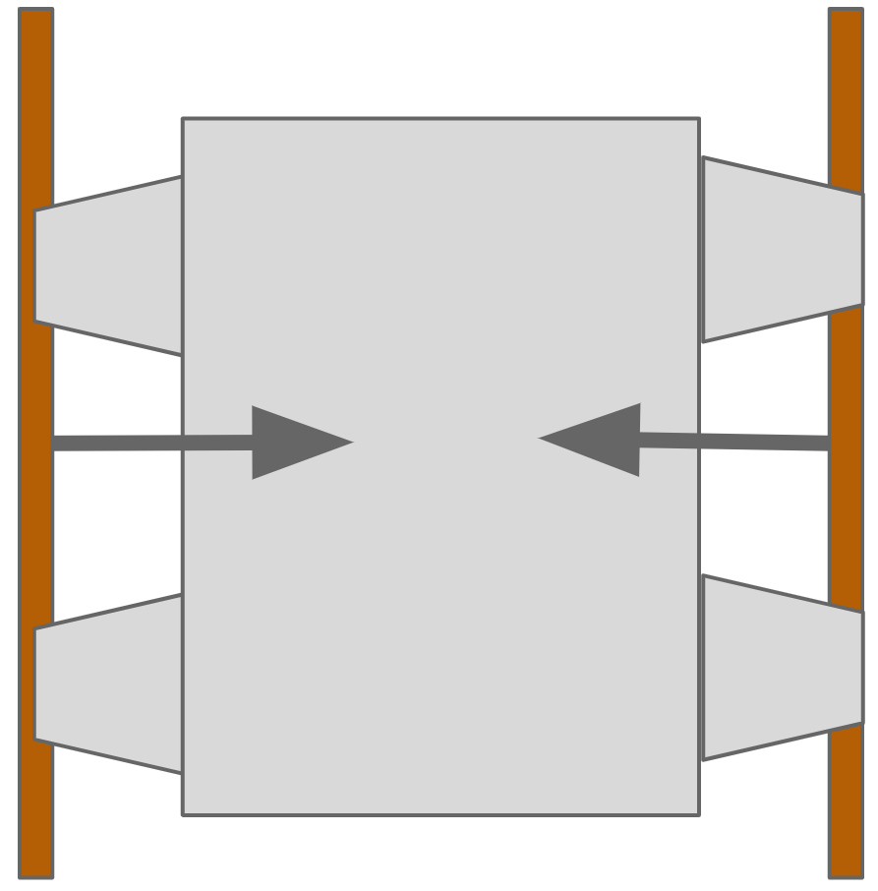
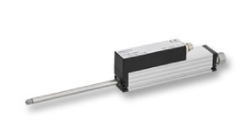
Concept Selection
How to Measure – Gauge
Chassis to Rail
Inductive
Laser/Photoelectric
Sensor to Sensor
Capacitive
LVIT or LVDT
Linear Variable Inductance Transducer
Linear Variable Differential Transformer
Notes:
Sean

Slide 22
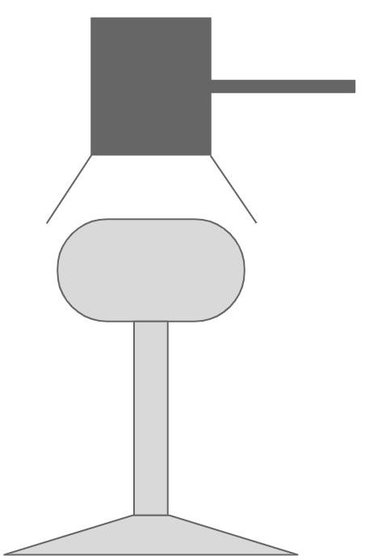
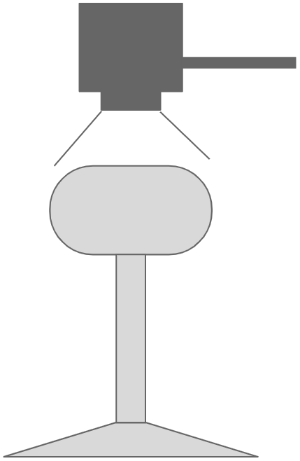
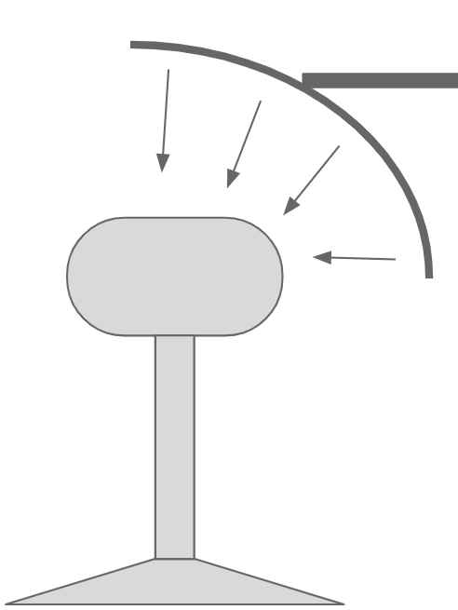
Concept Selection
How to Measure – Profile
Multiple points using Inductive, Capacitive, Photoelectric, or LVIT/LVDT
2D profile Laser Scanner
Camera + Machine Learning
Notes:
Sean

Slide 23
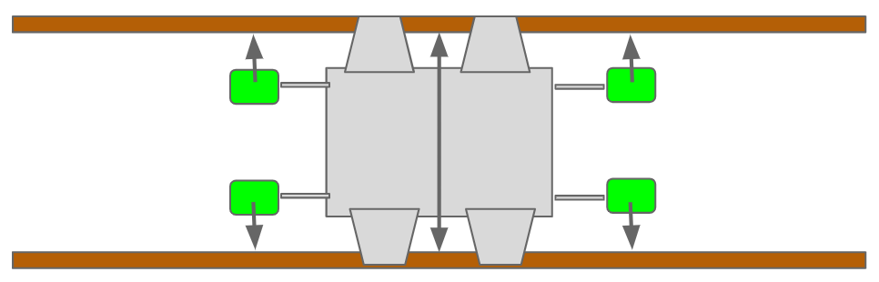
Concept Selection
How to Measure – Crosslevel & Curvature
Crosslevel
Gyroscope and accelerometer data
Curvature
Sensor banks extend beyond chassis
Data from each bank compared
Similar sensors to gauge setup
OR:
Angular acceleration data from accelerometer
Notes:
Sean

Slide 24
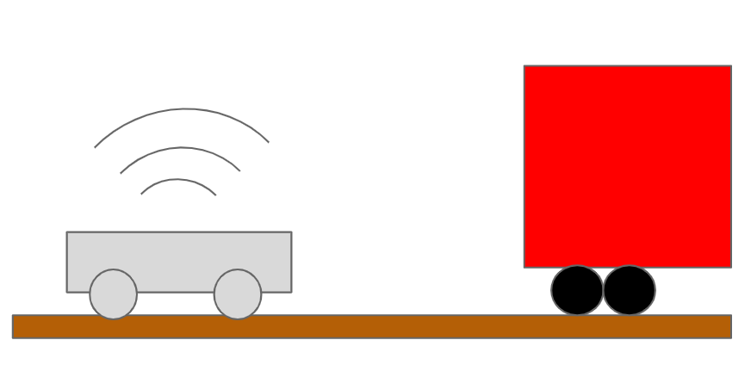
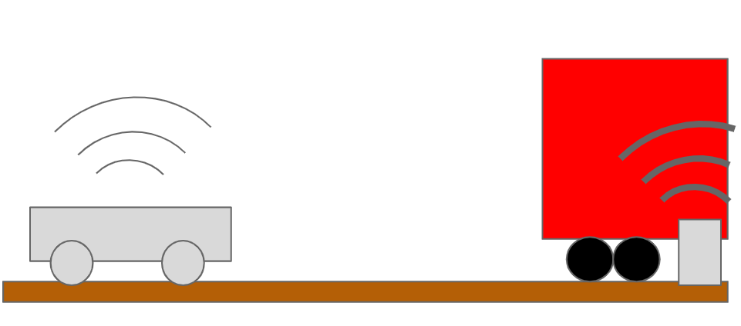
Concept Selection
Train Evasion - Trigger
Onboard Detection
External Detection
Notes:
Omar

Slide 25
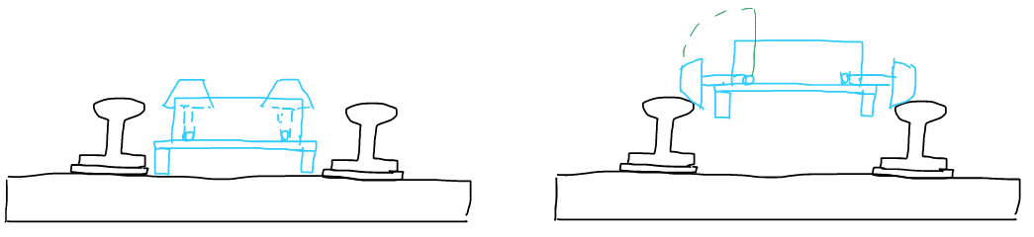
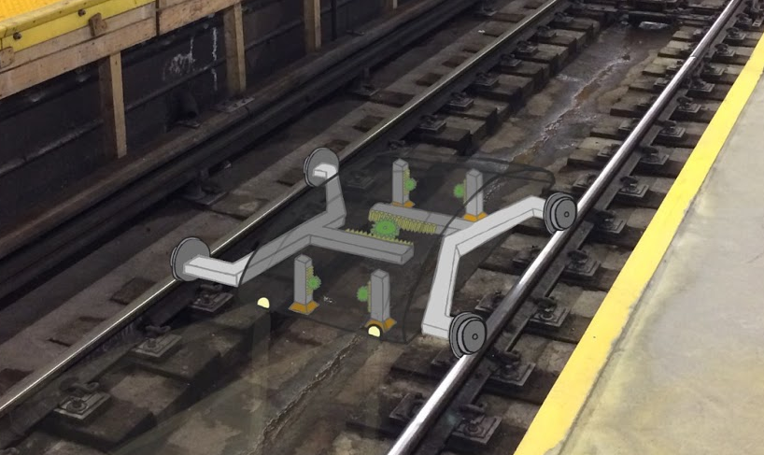
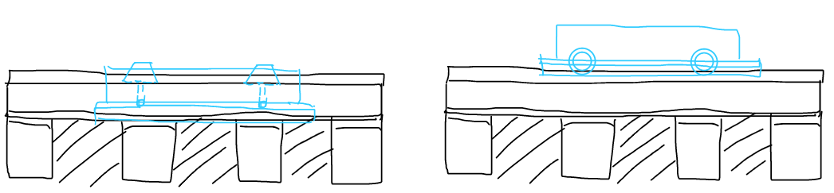
Concept Selection
Train Evasion - Mechanism
Concept 1: Folding Wheels
Concept 2: Retracting Wheels
Front View - Folded
Front View - Unfolded
Side View -Folded
Side View - Unfolded
Notes:
Omar

Slide 26
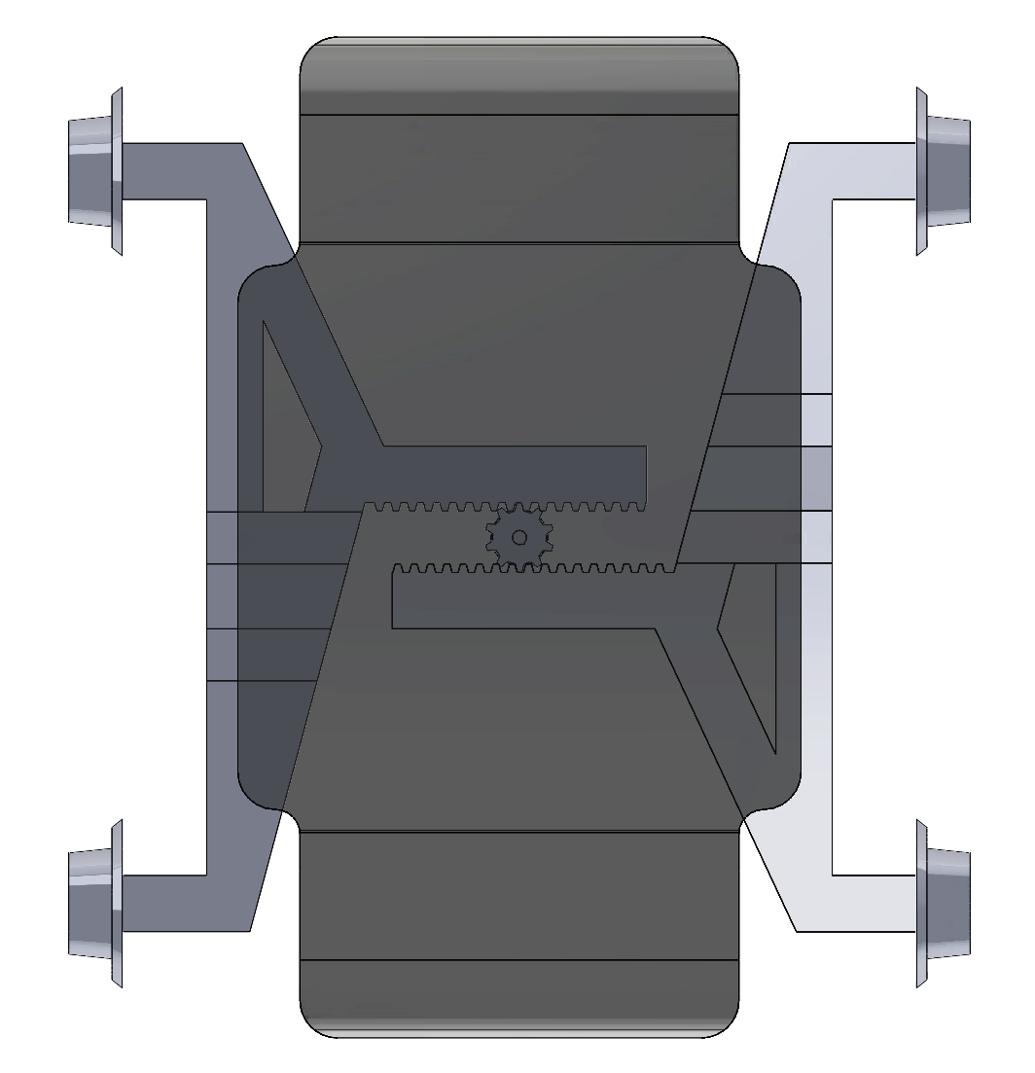
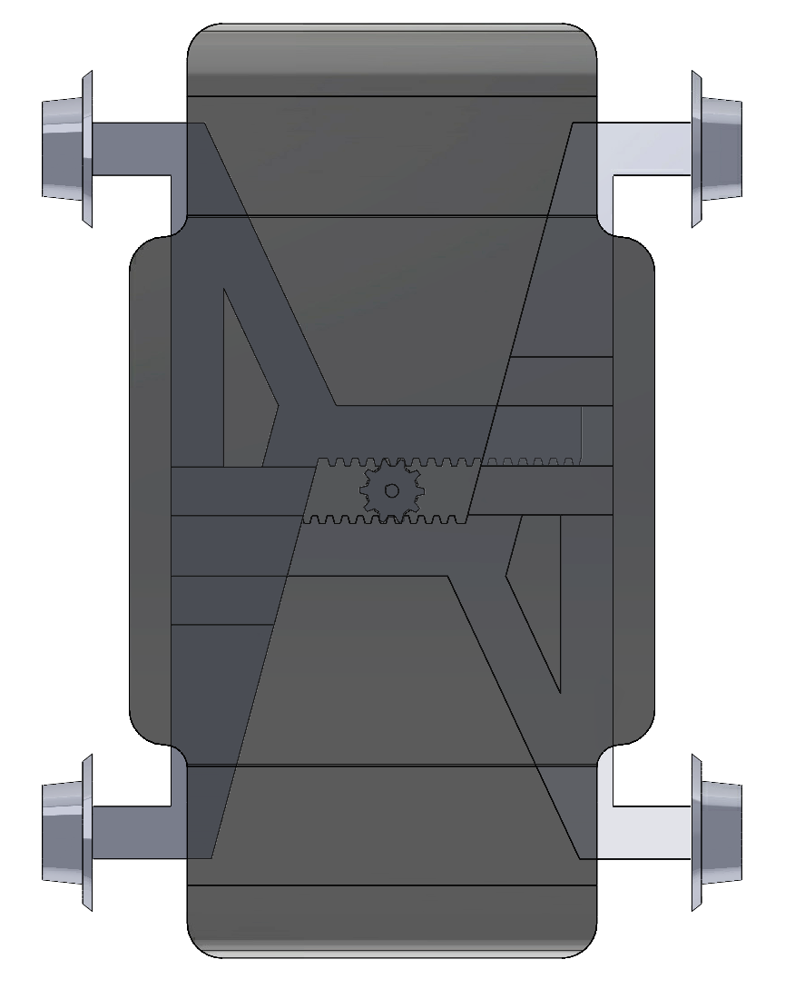
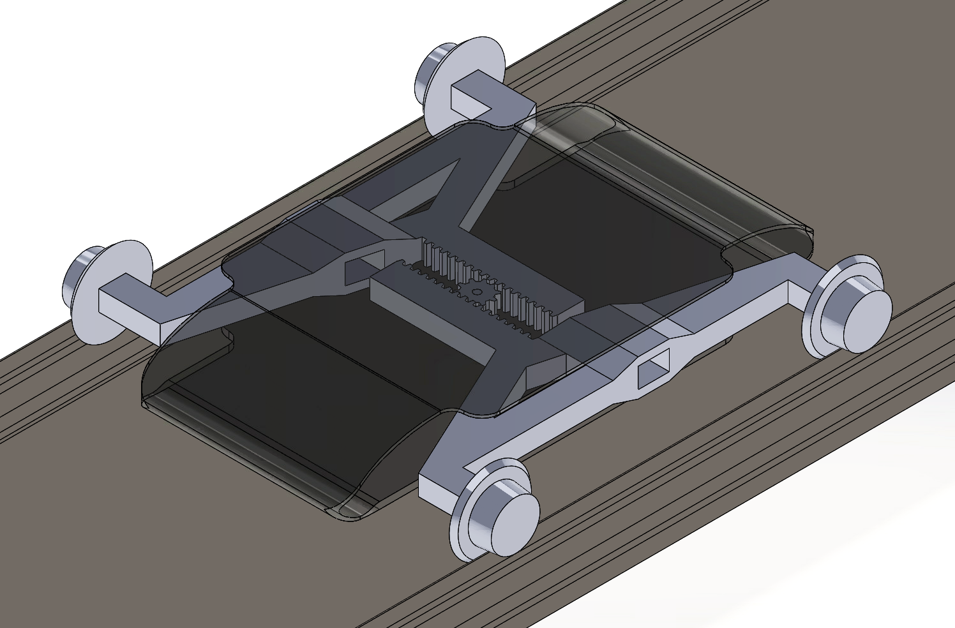
Concept Selection
Train Evasion - Mechanism
Concept 2a: Rack-and-Pinion
Top View - Extended
Top View - Retracted
Isometric View
Notes:
Omar

Slide 27
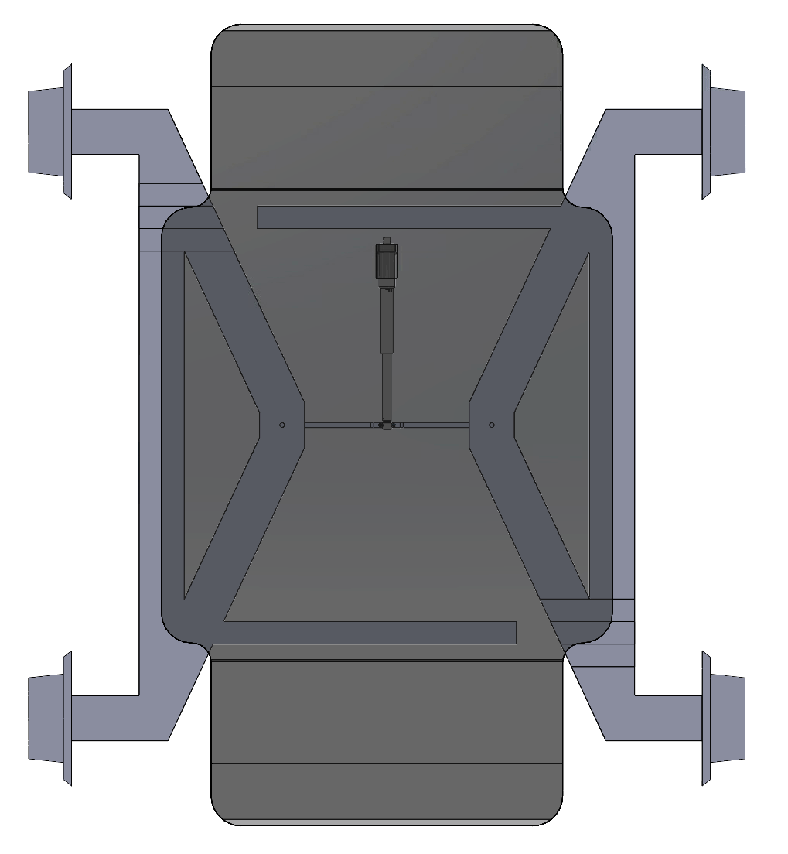
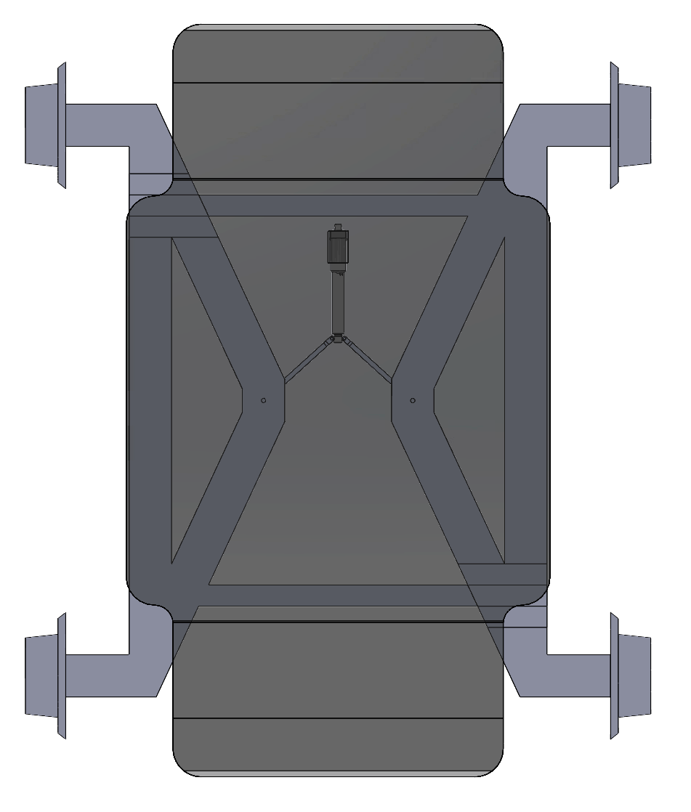
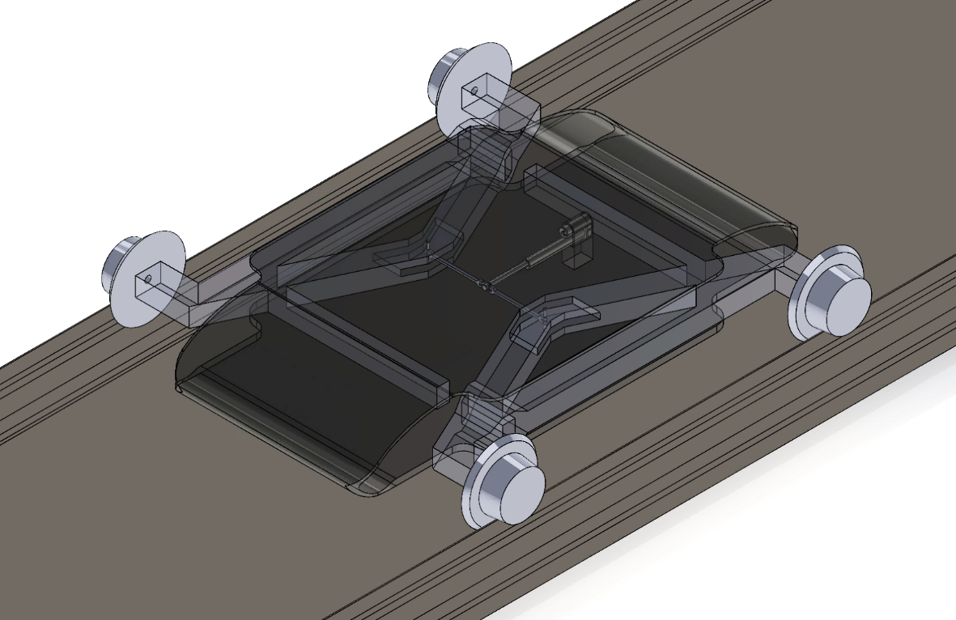
Concept Selection
Train Evasion - Mechanism
Concept 2b: Single Actuator (Mechanically Linked)
Top View - Extended
Top View - Retracted
Isometric View
Notes:
Omar

Slide 28
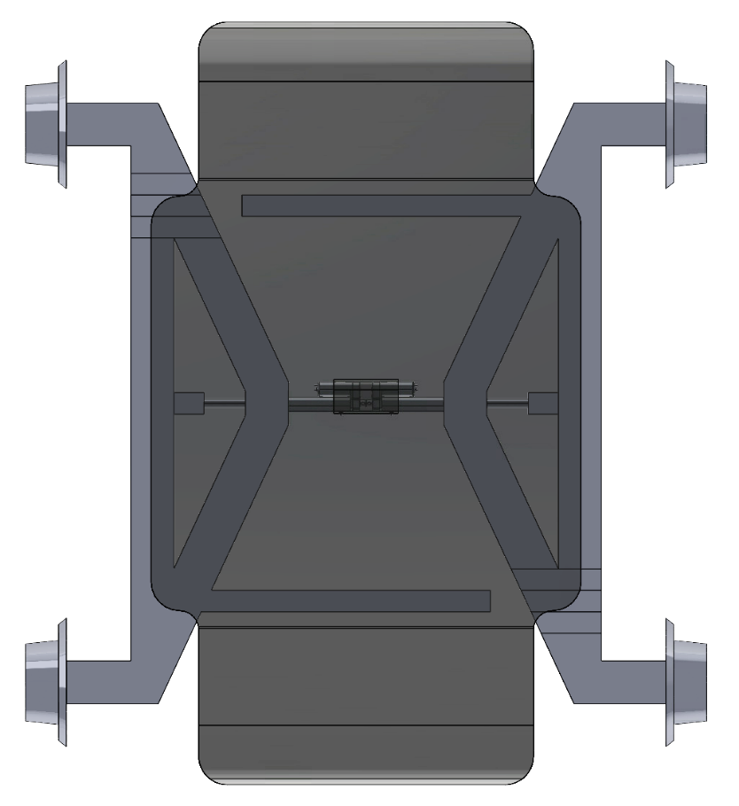
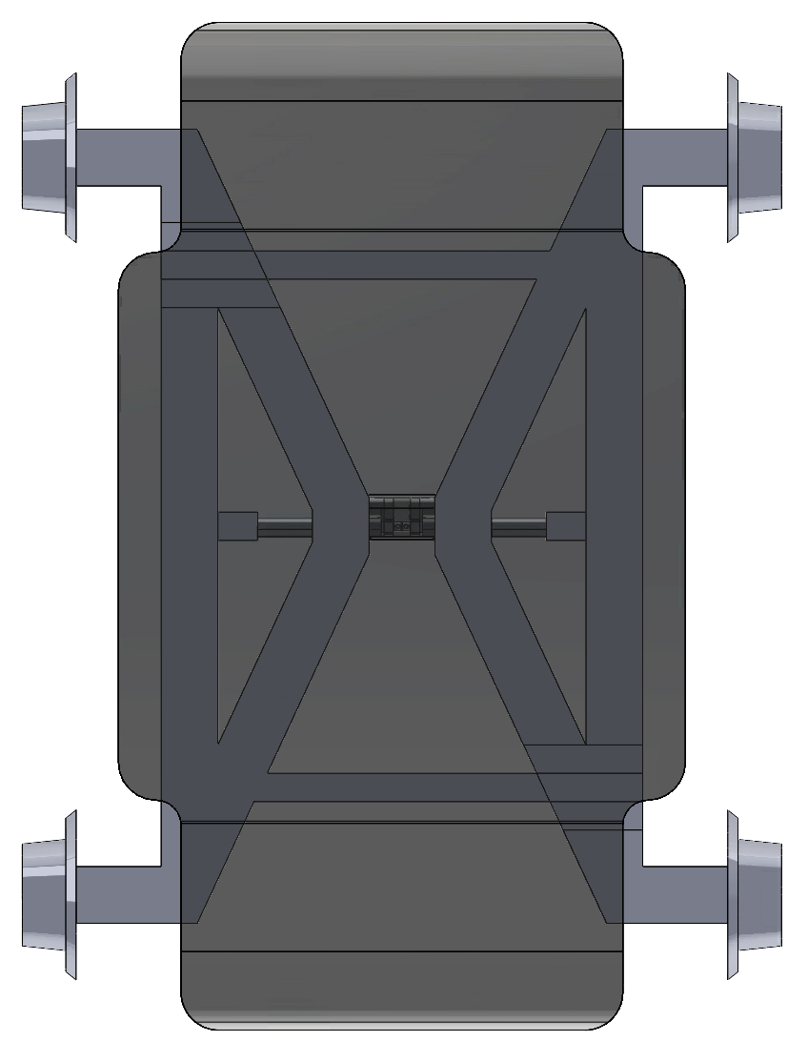
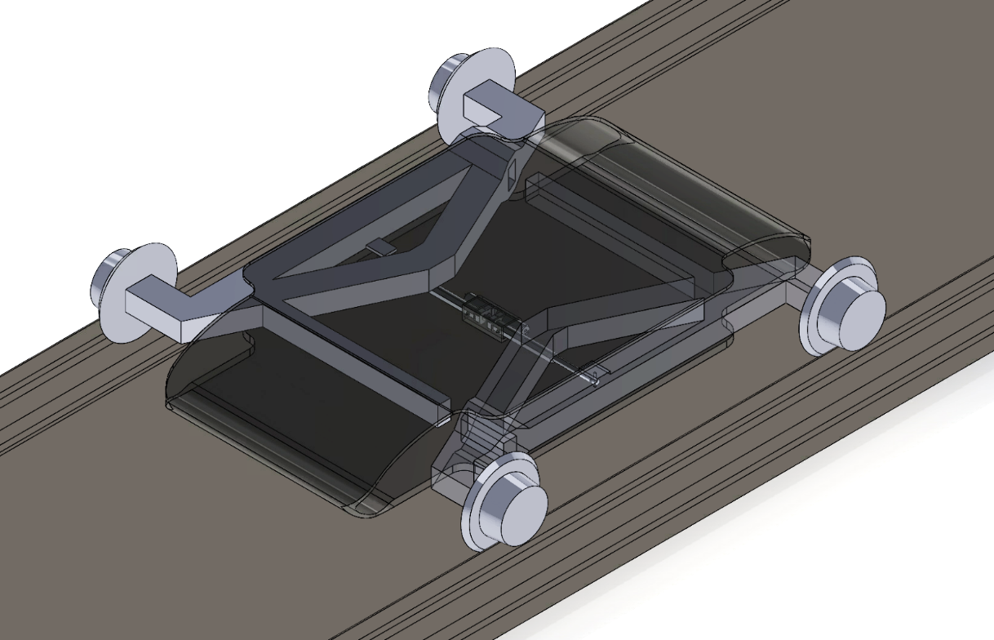
Concept Selection
Train Evasion - Mechanism
Concept 2b: Dual Actuator (Directly Driven)
Top View - Extended
Top View - Retracted
Isometric View
Notes:
Omar

Slide 29
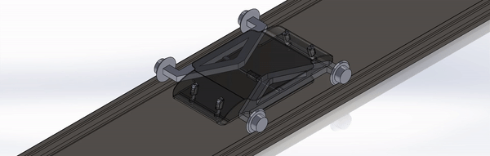
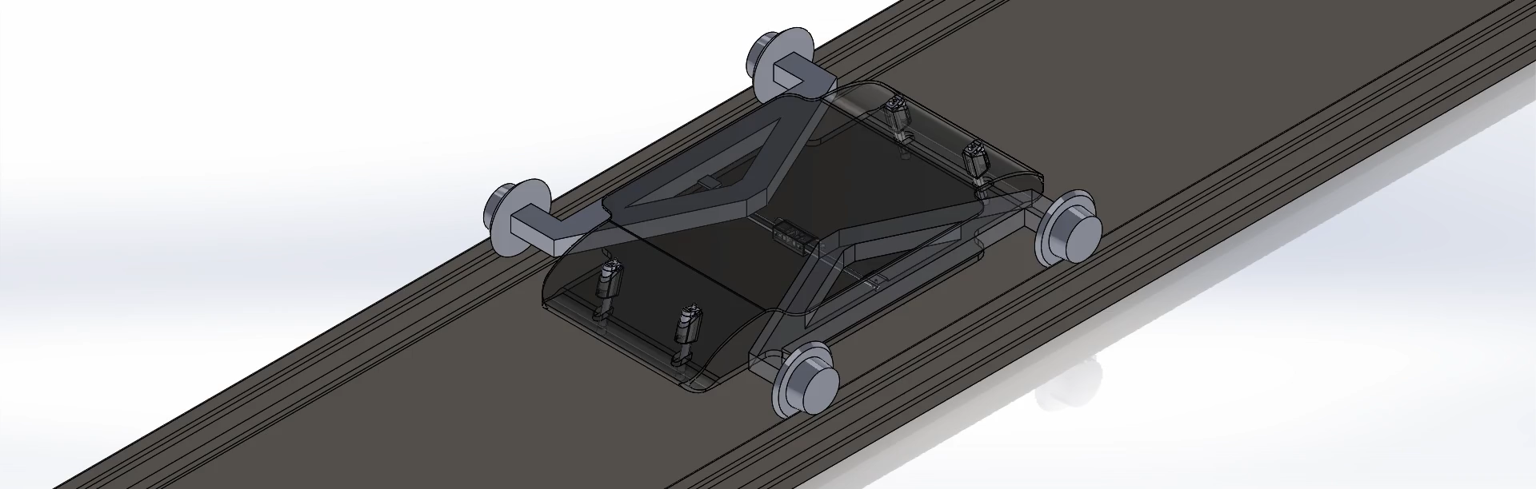
Concept Selection
Train Evasion - Mechanism
Dual Actuator Concept Simulation
Notes:
Omar

Slide 30
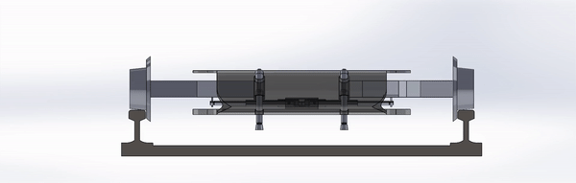
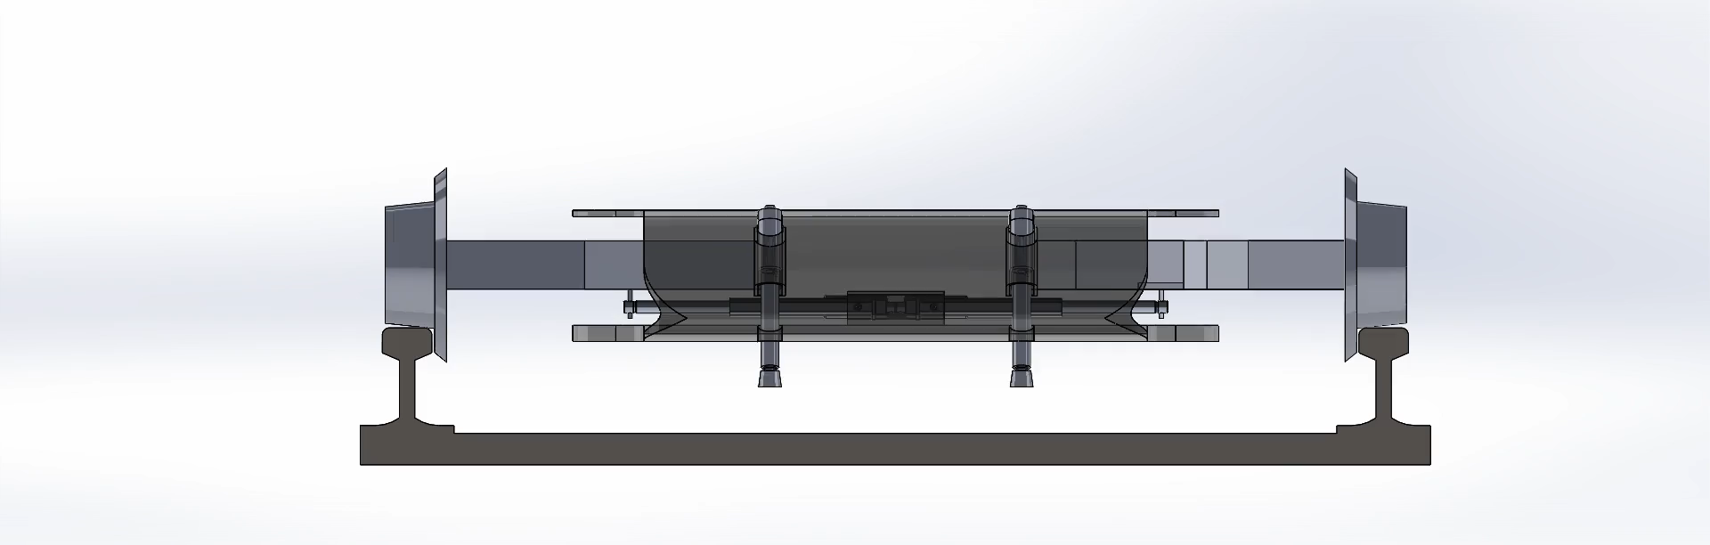
Concept Selection
Train Evasion - Mechanism
Dual Actuator Concept Simulation
Notes:
Omar

Slide 31
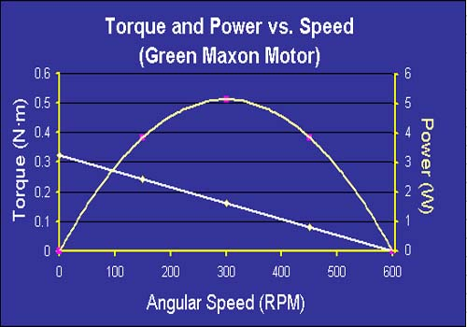
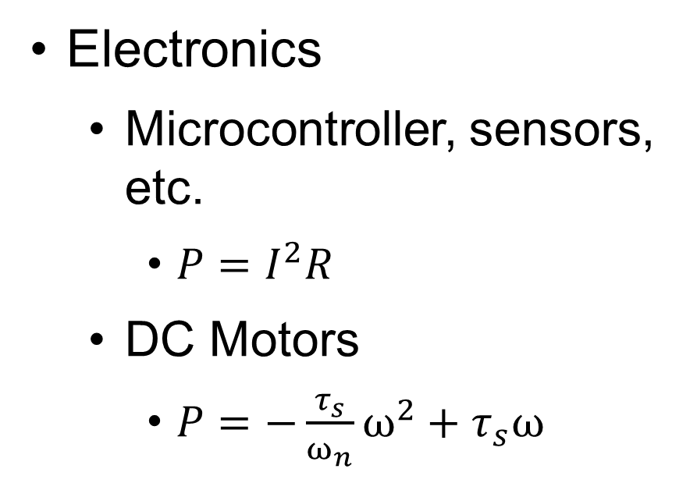
Technical Analysis
Power Calculations
Electronics
Microcontroller, sensors, etc.
$P=I^{2}R$
DC Motors
$P=−{\frac{τ_{s}}{ω_{n}}ω}^{2}+τ_{s}ω$
Motor Torque, Power, & Speed comparison
(MIT Center for Innovation in Product Development, 1999)
Notes:
Noah

Slide 32
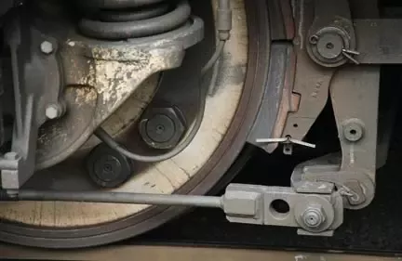
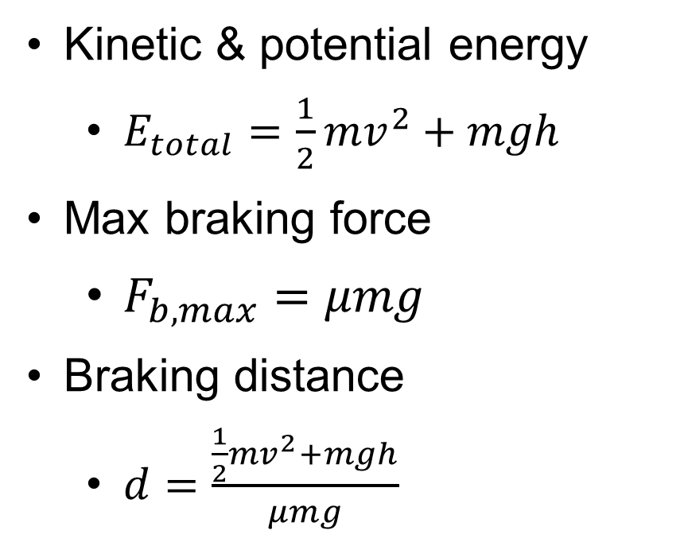
Technical Analysis
Braking Forces
Kinetic & potential energy
$E_{total}=\frac{1}{2}{mv}^{2}+mgh$
Max braking force
$F_{b,max}=μmg$
Braking distance
$d=\frac{\frac{1}{2}{mv}^{2}+mgh}{μmg}$
Train Braking System
(Quora, 2018)
Notes:
Noah

Slide 33
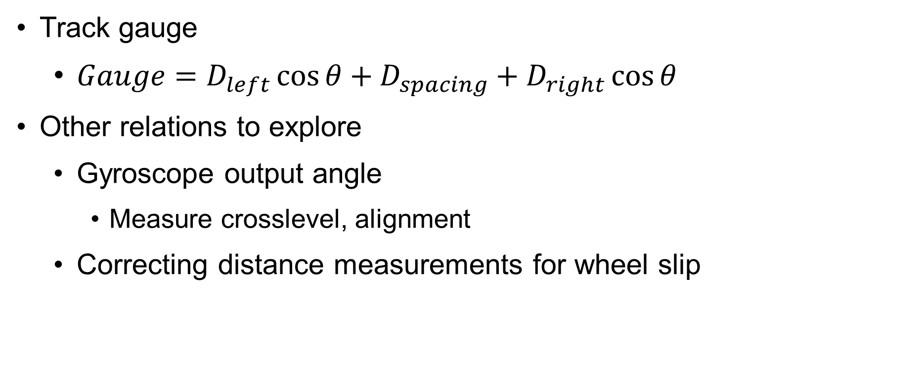
Technical Analysis
Sensor Calculations
Track gauge
$Gauge=D_{left}\cos{θ}+D_{spacing}+D_{right}\cos{θ}$
Other relations to explore
Gyroscope output angle
Measure crosslevel, alignment
Correcting distance measurements for wheel slip
Notes:
Noah

Slide 34
Moving Forward
Notes:
Anthony

Slide 35
Project Plan
Deliverables
Full CAD model
Alpha prototype
Testing location
Functionality testing
Defect testing
Analysis and recommendation
Notes:
Anthony

Slide 36
Project Plan
Preliminary Budget
Item: | Allocation:
Sensors | $200
3D Printed Parts | $150
Housing | $150
Drivetrain Parts | $200
Total: | $700
Notes:
Anthony

Slide 37
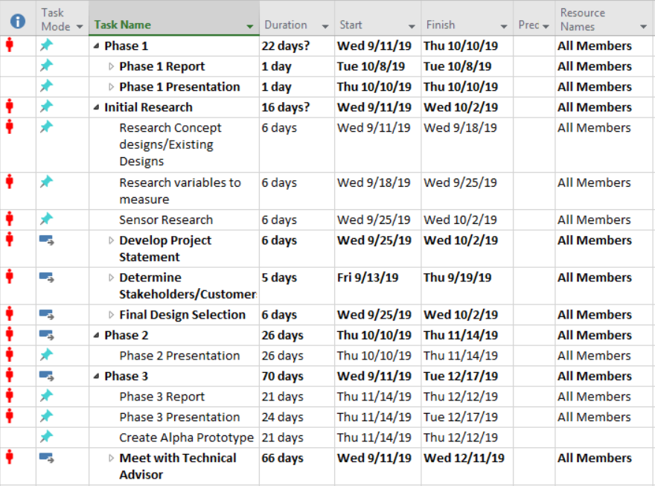
Project Plan
Condensed Timeline
Notes:
Anthony

Slide 38

Recap
Summary
Autonomous system to collect key track data
Measurement & evasion
Gauge, profile, level
Retract from track
Reduce costs, delays
Notes:
Anthony
*****RETURN TO THIS SLIDE WHEN PRESENTATION IS OVER********

Slide 39
Appendix

Slide 40

Appendix
Full Gantt Chart

Slide 41

Appendix
Gantt Chart Sec. 1

Slide 42

Appendix
Gantt Chart Sec. 2

Slide 43

Appendix
Gantt Chart Sec. 3

Slide 44
Appendix
References
“Graphic list of track gauges”, Track Gauge, Wikipedia
(By Rail_gauge.svg: http://commons.wikimedia.org/wiki/User:IRTC1015derivative work: HTML2011 (talk) - Rail_gauge.svg, Public Domain, https://commons.wikimedia.org/w/index.php?curid=17669390)
“Two commonly used rail profiles: a heavily worn 50-kg/m profile and a new 60-kg/m profile”, Rail Profile, Wikipedia
(By MADe - Own work, CC BY-SA 3.0, https://commons.wikimedia.org/w/index.php?curid=3440945)
Linear Rod with Return Spring, Novotecknik, website
(https://www.novotechnik.com/Linear-Rod-With-Return-Spring/linear-rod-ret-spr.html)
“Inductive sensors (eddy current) for displacement, distance and position”, Sensors for Displacement, Distance and Position, Micro-Epsilon, website
(https://www.micro-epsilon.com/displacement-position-sensors/)
“Capacitive displacement sensors and measurement systems”, Sensors for Displacement, Distance and Position, Micro-Epsilon, website
(https://www.micro-epsilon.com/displacement-position-sensors/)

Slide 45
Appendix
References
“Laser sensors for displacement, distance and position”, Sensors for Displacement, Distance and Position, Micro-Epsilon, website
(https://www.micro-epsilon.com/displacement-position-sensors/)
“The measurement of crosslevel between two rails”, Track Geometry, Wikipedia
(By Z22 - Own work, CC0, https://commons.wikimedia.org/w/index.php?curid=22764594)
Train Track Clipart, Clip Art Mag, website
(http://clipartmag.com/train-track-clipart)
“Inductive Sensing”, Proximity Sensors Compared: Inductive, Capacitive, Photoelectric, and Ultrasonic, MachineDesign, website
(https://www.machinedesign.com/sensors/proximity-sensors-compared-inductive-capacitive-photoelectric-and-ultrasonic#menu)
“Capacitive Sensing”, Proximity Sensors Compared: Inductive, Capacitive, Photoelectric, and Ultrasonic, MachineDesign, website
(https://www.machinedesign.com/sensors/proximity-sensors-compared-inductive-capacitive-photoelectric-and-ultrasonic#menu)
“Photoelectric/Ultrasonic Sensing Setups”, Proximity Sensors Compared: Inductive, Capacitive, Photoelectric, and Ultrasonic, MachineDesign, website
(https://www.machinedesign.com/sensors/proximity-sensors-compared-inductive-capacitive-photoelectric-and-ultrasonic#menu)

